Slide 1
Advanced .NET Programming I
7th Lecture
Pavel Ježek
pavel.jezek@d3s.mff.cuni.cz
Some of the slides are based on University of Linz .NET presentations.
© University of Linz, Institute for System Software, 2004
published under the Microsoft Curriculum License
(http://www.msdnaa.net/curriculum/license_curriculum.aspx)

Slide 2
Query Expressions – Examples
Query expression:
from c in customers where c.City == "London“ select c
Gets translated to:
customers.Where(c => c.City == "London")

Slide 3
Query Expressions – Examples
Query expression:
from c in customers where c.City == "London" select c.Name
Gets translated to:
customers.Where(c => c.City == "London").Select(c => c.Name)

Slide 4
Query Expressions – Examples
Query expression:
from c in customers orderby c.Name select new { c.Name, c.City }
Gets translated to:
customers.OrderBy(c => c.Name).Select(c => new { Name = c.Name, City = c.City })

Slide 5
Query Expressions – Examples
Query expression:
from c in customers where c.City == "London" orderby c.Name select new { c.City, c.Name }
Gets translated to:
customers.Where(c => c.City == "London").OrderBy(c => c.Name).Select(c => new { c.City, c.Name })
NOTE – is equivalent to (i.e. “c” variables in lambdas are not related to each other):
customers.Where(c1 => c1.City == "London").OrderBy(c2 => c2.Name).Select(c3 => new { c3.City, c3.Name })

Slide 6
Query Expressions
Query expressions or LINQ (Language INtergrated Queries) are the key feature of .NET 3.5
Query expressions are translated to method calls – works on classes like:
delegate R Func<A,R>(A arg);
class C<T>
{
public C<T> Where(Func<T,bool> predicate);
public C<S> Select<S>(Func<T,S> selector);
public C<S> SelectMany<S>(Func<T,C<S>> selector);
public O<T> OrderBy<K>(Func<T,K> keyExpr);
public O<T> OrderByDescending<K>(Func<T,K> keyExpr);
public C<G<K,T>> GroupBy<K>(Func<T,K> keyExpr);
public C<G<K,E>> GroupBy<K,E>(Func<T,K> keyExpr, Func<T,E> elemExpr);
…
}

Slide 7
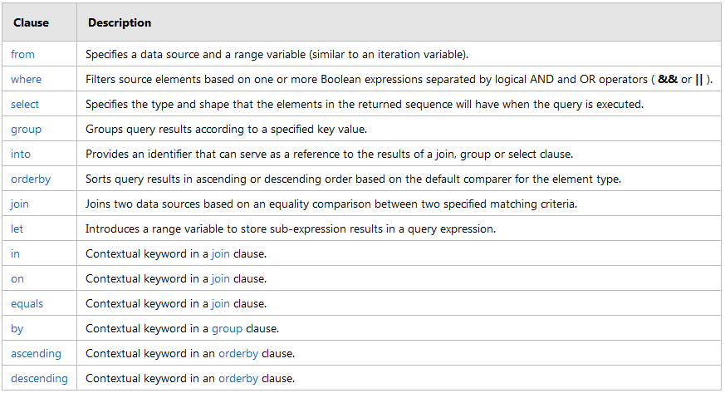
Query Expressions – Query Ops (MSDN)
α let a = b β
α.Select(x => new { x, a = b}).β

Slide 8
LINQ to Objects
Set of generic extension methods (Select, Where, OrderBy, etc.) implemented for IEnumerable<T> interface (provided by static class Enumerable), example:
int[] numbers = { 5, 4, 1, 3, 9, 8, 6, 7, 2, 0 };
var numberGroups = from n in numbers group n by n % 5 into g
select new { Remainder = g.Key, Numbers = g };
foreach (var g in numberGroups) {
Console.WriteLine(
"Numbers with a remainder of {0} when divided by 5:", g.Remainder
);
foreach (int n in g.Numbers) {
Console.WriteLine(n);
}
}
LINQ to * - Classes for * data access using query expressions
NOTE: For any LINQ implementation it is commonly expected (but not
enforced [see LinqToNothing example]), that the “resulting” type of any
query implements at least the IEnumerable interface.
Numbers with a remainder of 0 when divided by 5:
5
0
Numbers with a remainder of 4 when divided by 5:
4
9
Numbers with a remainder of 1 when divided by 5:
1
6
Numbers with a remainder of 3 when divided by 5:
3
8
Numbers with a remainder of 2 when divided by 5:
7
2

Slide 9
Query Expressions – Examples
Query expression:
from c in customers orderby c.Name orderby c.City select new { c.City, c.Name }
Gets translated to:
customers.OrderBy(c => c.Name).OrderBy(c => c.City).Select(c => new
{ c.City, c.Name })

Slide 10
Query Expressions – Examples
Query expression:
from c in customers orderby c.Name, c.City select new { c.City, c.Name }
Gets translated to:
customers.OrderBy(c => c.Name).ThenBy(c => c.City).Select(c => new
{ c.City, c.Name })

Slide 11
Query Expressions – Query Ops (MSDN)
α let a = b β
α.Select(x => new { x, a = b}).β

Slide 12
Query Expressions – SelectMany
Query expression:
from c in customers
where c.City == "London"
from o in c.Orders
where o.OrderDate.Year == 2005
select new { c.Name, o.OrderID, o.Total }
Gets translated to:
customers.Where(c => c.City == "London").
SelectMany(c =>
c.Orders.
Where(o => o.OrderDate.Year == 2005).
Select(o => new {
Name = c.Name, OrderID = o.OrderID, Total = o.Total })
)

Slide 13
Query Expressions – Query Ops (MSDN)
α let a = b β
α.Select(x => new { x, a = b}).β

Slide 14
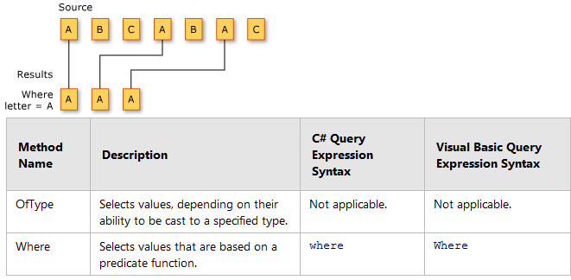
Filtering (MSDN)

Slide 15
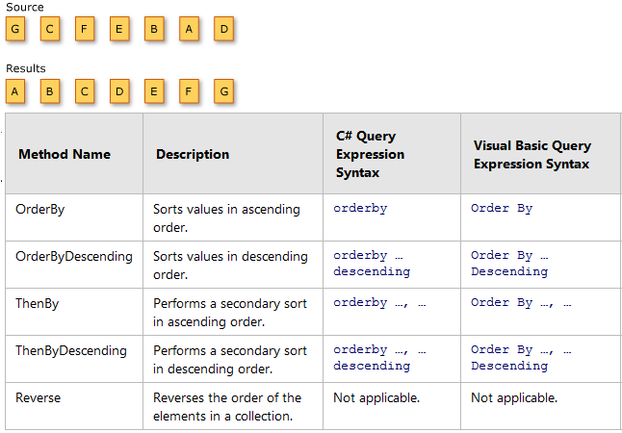
Sorting (MSDN)

Slide 16
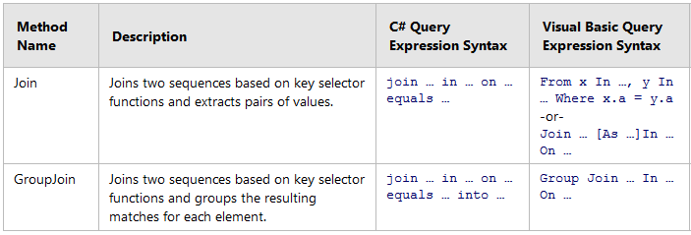
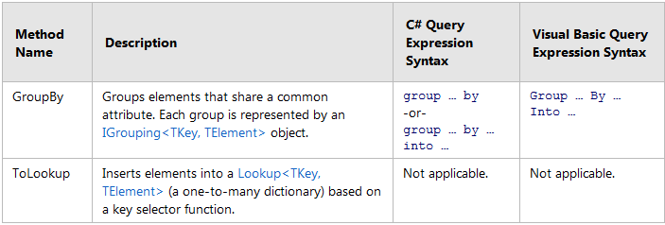
Inner Join + Grouping (MSDN)

Slide 17
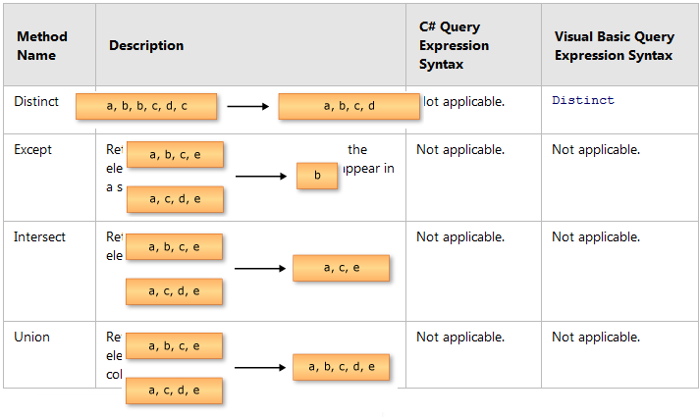

Set Ops (MSDN)
Zip
zip operation defined by passed delegate

Slide 18
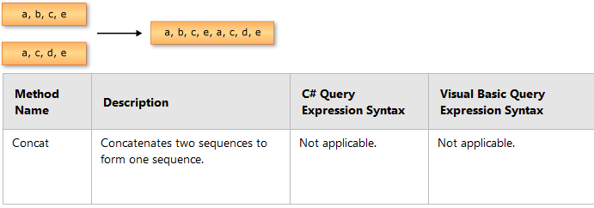
Concat (MSDN)

Slide 19
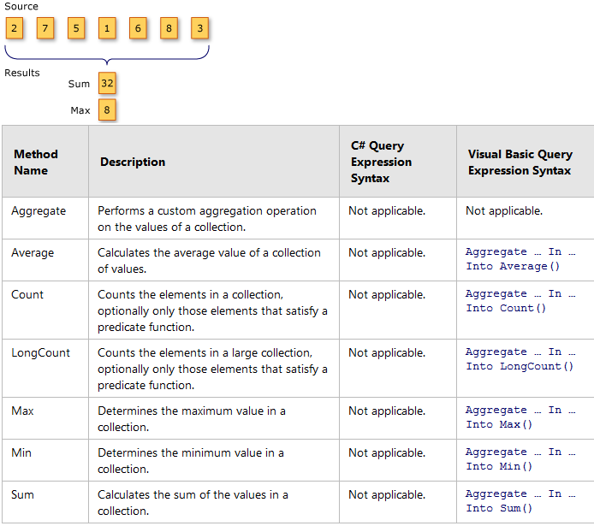
Aggregate Functions (MSDN)

Slide 20
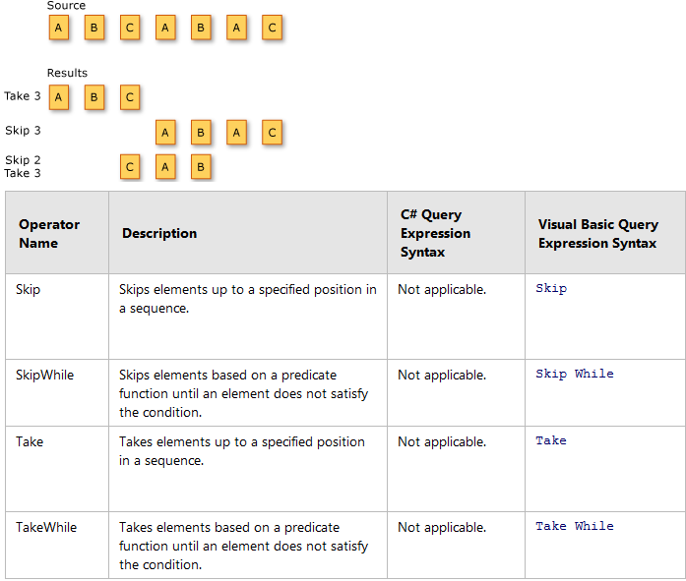
Partitioning (MSDN)
.SkipWhile(x => x < 3)

Slide 21
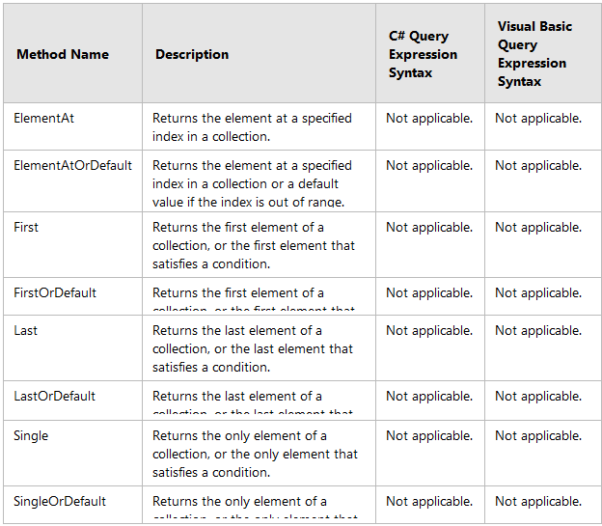
Element Ops (MSDN)
First = ignore rest
Single = check single only, if not → error (exception)

Slide 22
Testing Conditions
public static bool All<TSource>(
this IEnumerable<TSource> source, Func<TSource, bool> predicate
)
public static bool Any<TSource>(
this IEnumerable<TSource> source
)
public static bool Any<TSource>(
this IEnumerable<TSource> source, Func<TSource, bool> predicate
)
public static bool Contains<TSource>(
this IEnumerable<TSource> source, TSource value
)
public static bool SequenceEqual<TSource>(
this IEnumerable<TSource> first, IEnumerable<TSource> second
)

Slide 23
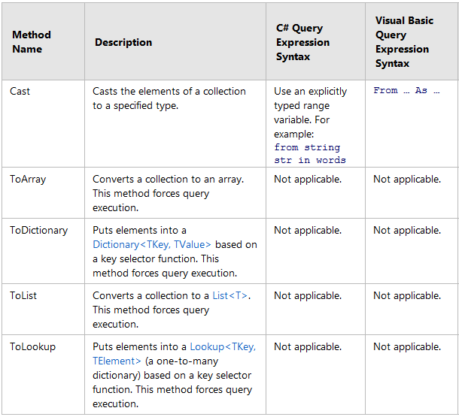
Conversions (MSDN)

Slide 24
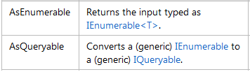

Conversions (MSDN)
+ the rare magic:
(let’s ignore these for now)

